Slide 1

RATE

Slide 2


Slide 4
RATE

Slide 5
RATE

Slide 6
RATE

Slide 7
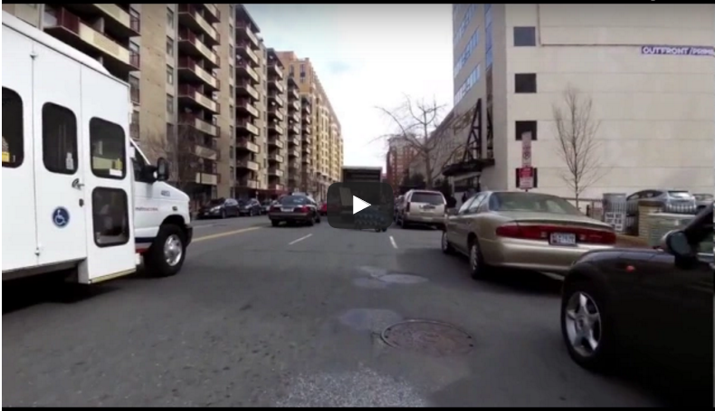
RATE

